Slide 1
NRLFLARE -- Updates

Slide 2
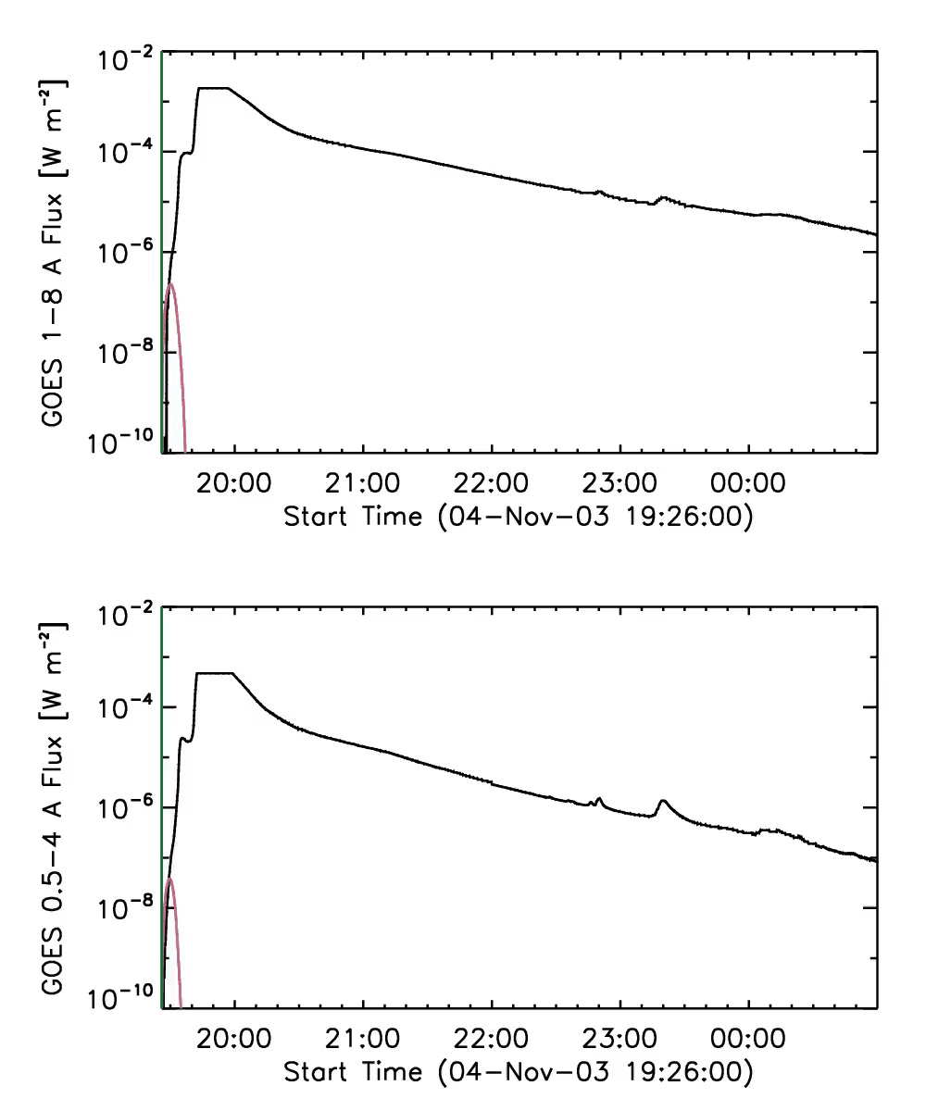
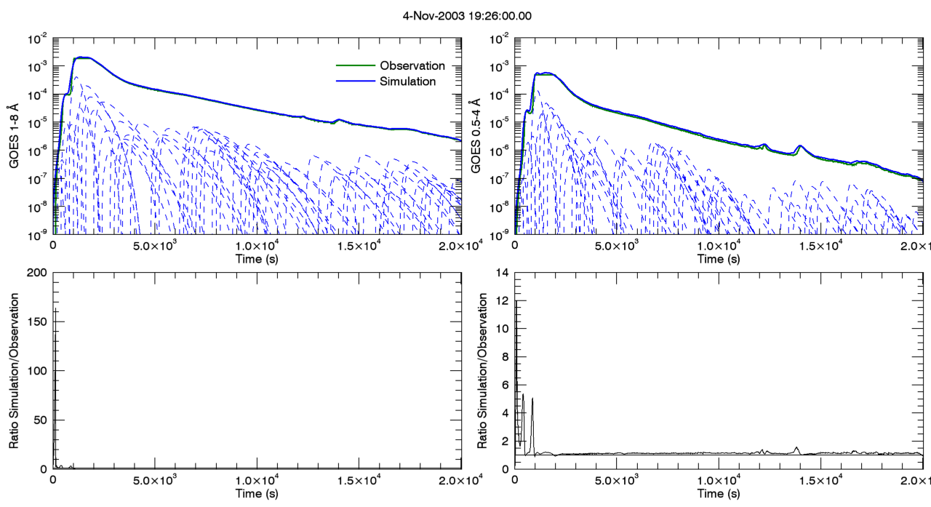
04 November 2003 X?? Flare
Reep

Slide 3
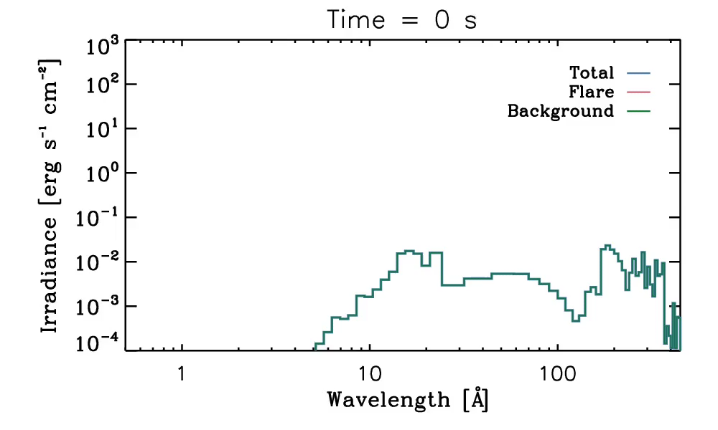
04 November 2003 X?? Flare
Reep

Slide 4
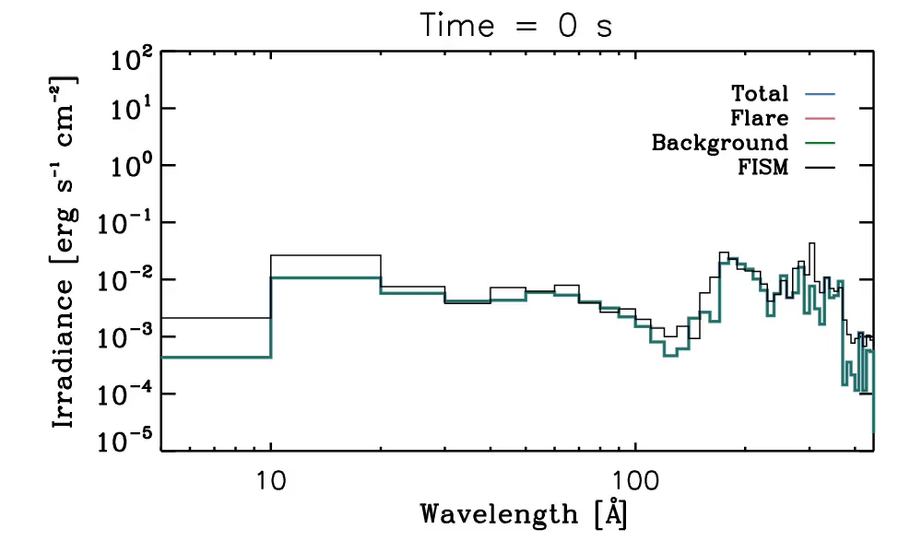
04 November 2003 X?? Flare
Reep

Slide 5
Outstanding Issues
Reep
1. Still need accurate background model (in progress!)
-- Will use EVE data to estimate DEM for various solar conditions, then synthesize background spectrum
-- For time being, use EUVAC or?
2. Current calculation only goes to 450 A
-- (background’s limit)
3. Optically thick lines
-- Need to use 1D simulations (need more!)
-- Model working, but GOES doesn’t have great fits yet

Slide 6
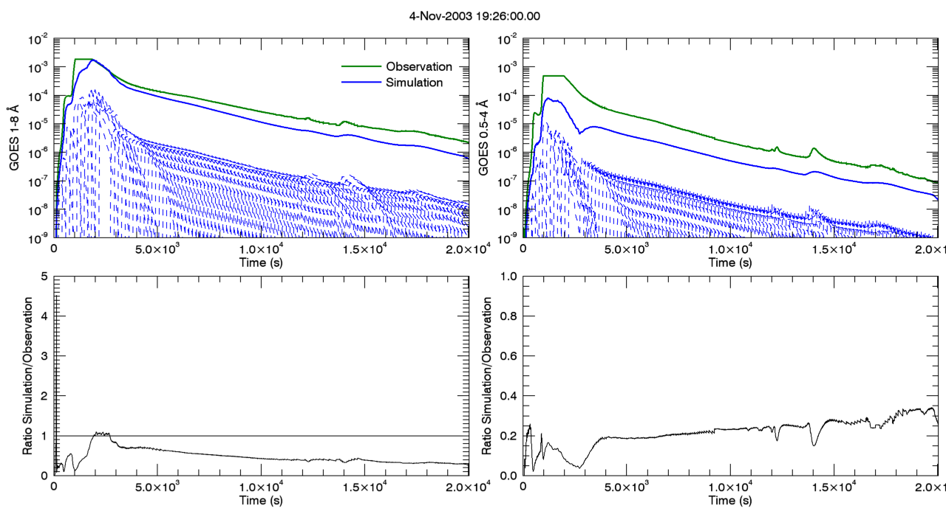
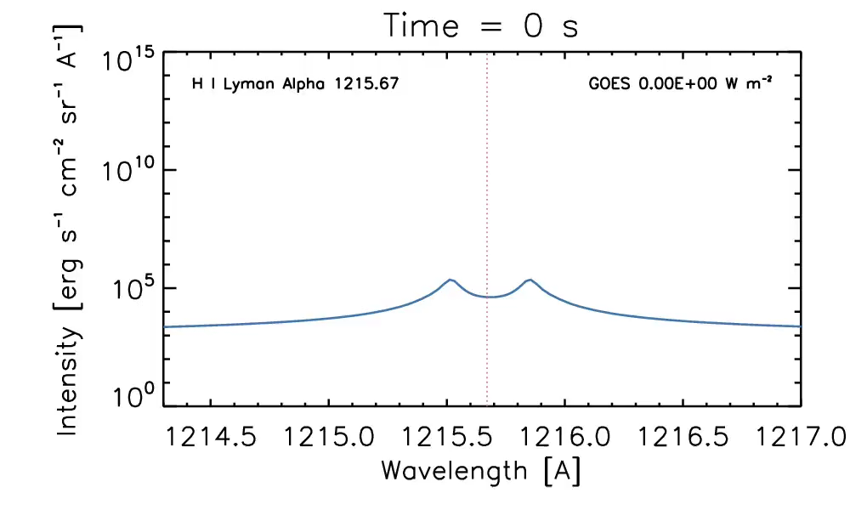
Need better fits with 1D model
Reep

Slide 7
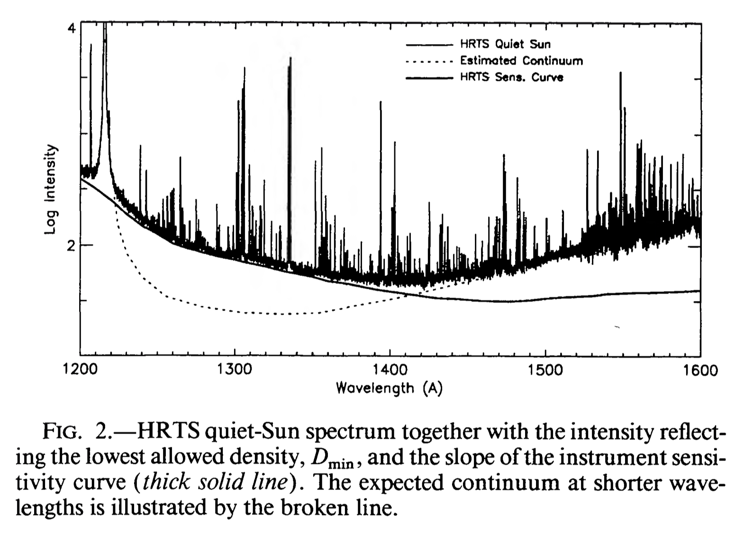
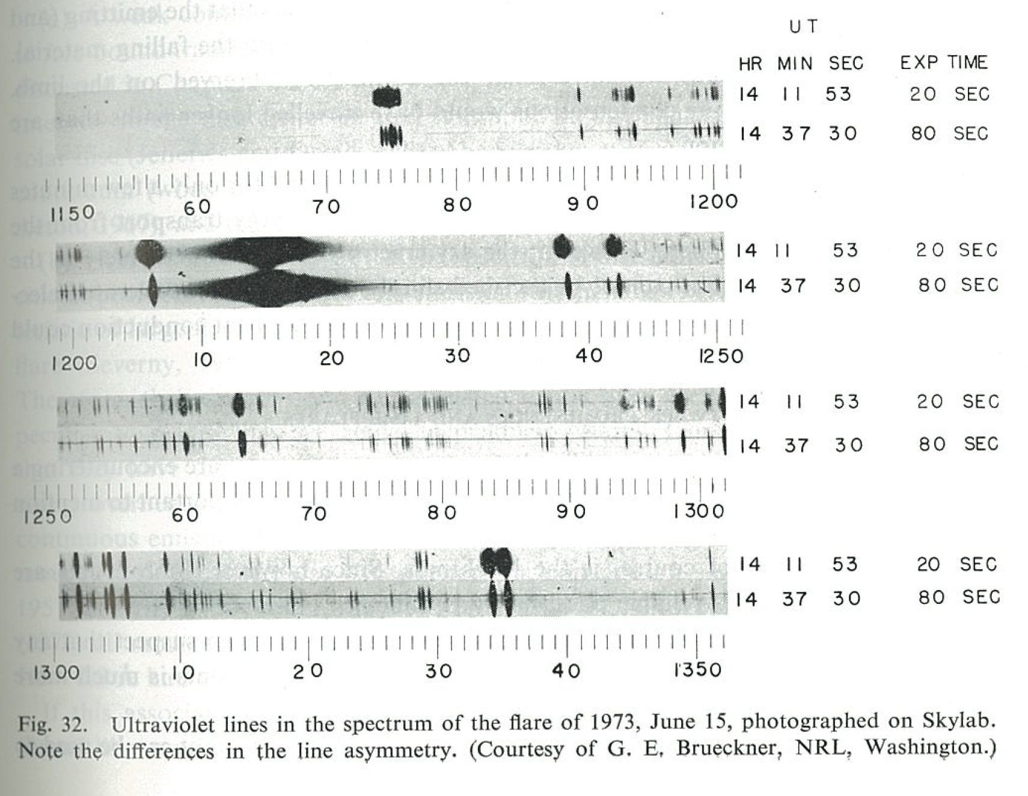
No Lyman-𝛂 line profiles in flares to validate against…
Reep
Quiet sun and saturated!
No chance in flares…

